Slide 1

Projects details:
Project title: Forecasting Air Quality Using Historical Pollution Data
Project Purpose:
Predict future AQI and pollutant levels using historical air quality data.
Support authorities & public health with early warnings and preventive actions.
Enable data-driven environmental planning for a cleaner and healthier future.
Tools and technologies: Python, Pandas, NumPy, Matplotlib, Seaborn, Scikit-learn, Plotly, ARIMA/Prophet/LSTM/XgBoost, Flask, Streamlit, HTML-CSS-JavaScript
Mentor: Ms. Umme Asma S
Batch Number: 3
Start Date : 22-September-2025
Presented By : Shruti Singh
Intern Name: Shruti Singh

Slide 2
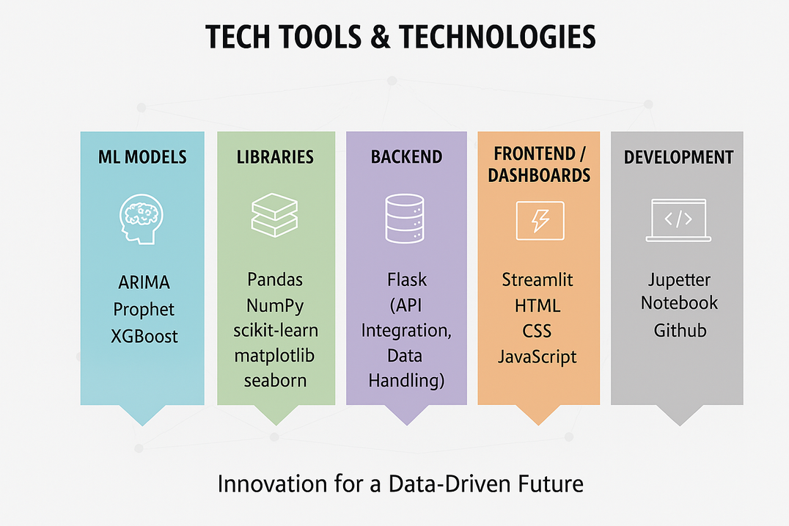
PROJECT OBJECTIVES
Purpose
The primary goal of AirAware is to develop an air quality monitoring and forecasting system that helps cities, environmental agencies, and citizens understand and respond to pollution trends in real time.
It focuses on:
Predicting Air Quality Index (AQI) using time-series forecasting models.
Analyzing pollutant behavior (PM2.5, PM10, O₃, NO₂, SO₂, CO).
Providing early alerts for unhealthy air conditions.
Visualizing pollutant patterns and forecast results through interactive dashboards.
Tech Tools & Technologies:
Language : Python

Slide 3
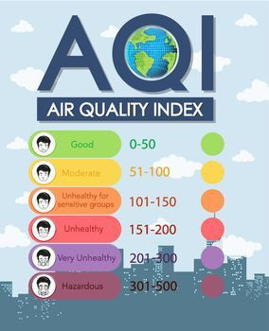
WHAT IS THE AIR QUALITY INDEX?
The Air Quality Index (AQI) is a tool used by government agencies to communicate how polluted the air is or is forecast to become.
It runs on a scale from 0 to 500. The higher the AQI value, the greater the level of air pollution and the greater the health concern.
The scale is color-coded for simplicity, from "Good" (Green) to "Hazardous" (Maroon).
This index helps you understand what local air quality means for your health.

Slide 4
THE 8 REGULATED POLLUTANTS
Particulates & Gases
PM2.5: Fine inhalable particles (2.5 microns).
PM10: Inhalable particles (10 microns).
Ground-Level Ozone (O3): A harmful gas created by chemical reactions.
Carbon Monoxide (CO): Toxic gas from incomplete combustion.
Industrial & Chemical
Sulphur Dioxide (SO2): From burning sulfur-rich fossil fuels.
Nitrogen Dioxide (NO2): From high-temperature combustion.
Ammonia (NH3): From agricultural and industrial processes.
Lead (Pb): A toxic heavy metal from metal processing.

Slide 5
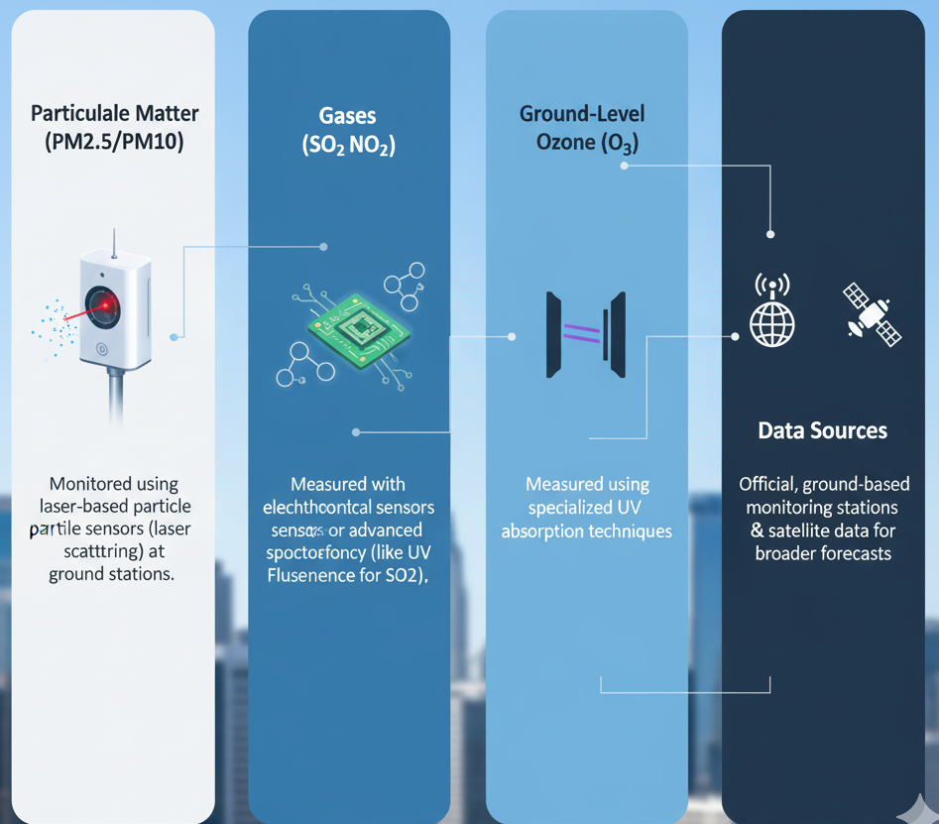
HOW ARE THESE POLLUTANTS MEASURED?
Particulate Matter (PM2.5/PM10): Monitored using laser-based particle sensors (laser scattering) at ground stations.
Gases (CO, SO2, NO2): Measured with electrochemical sensors or advanced spectroscopy (like UV Fluorescence for SO2).
Ground-Level Ozone (O3): Measured using specialized UV absorption techniques.
Data Sources: Data is collected from official, ground-based monitoring stations and often supplemented by satellite data for broader forecasts.

Slide 6
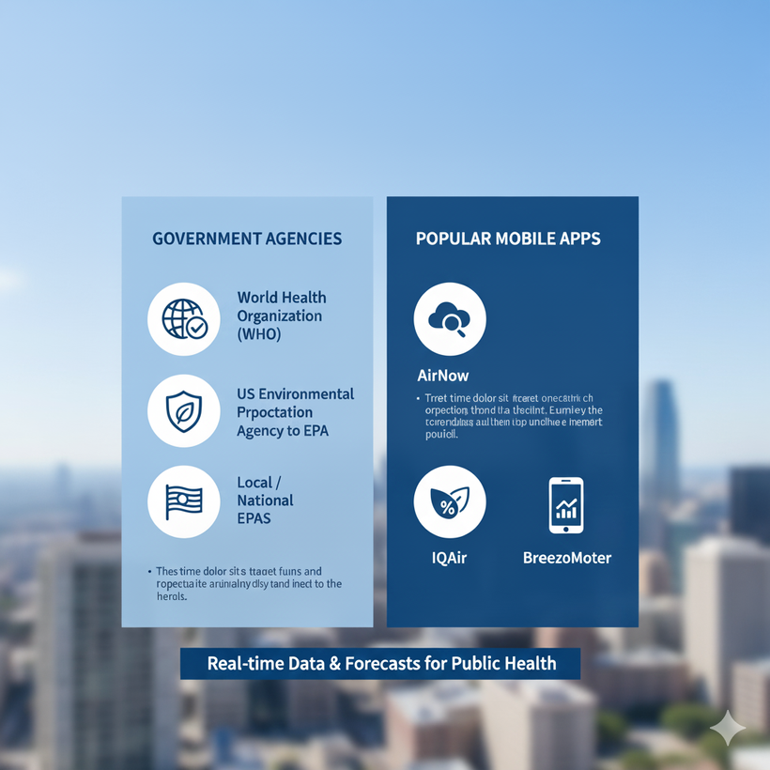
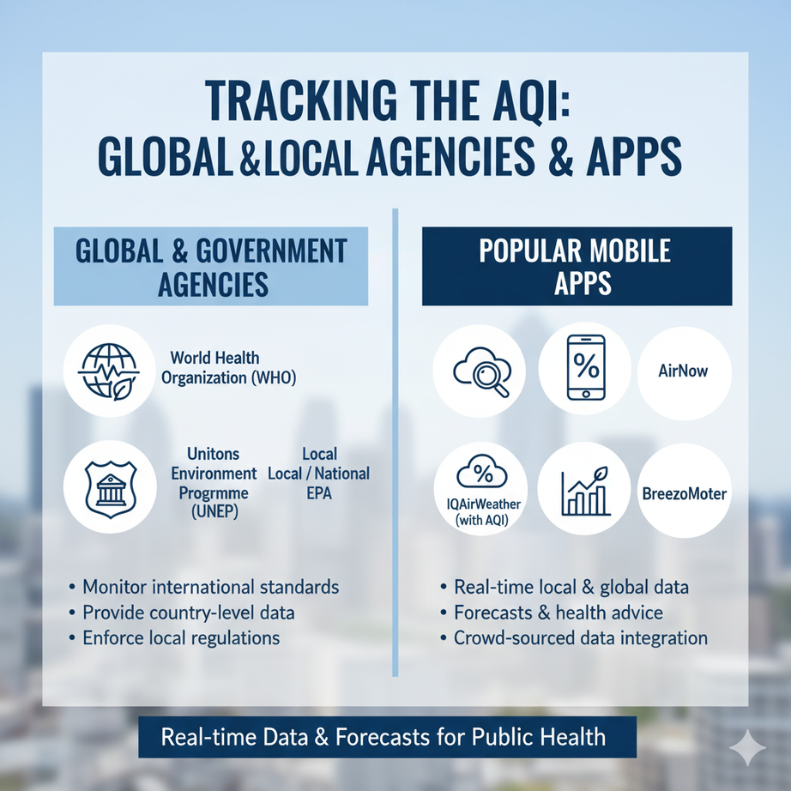
TRACKING THE AQI: AGENCIES & APPS
Access to AQI data is provided by official agencies and user-friendly apps.
Official Agencies (India):
CPCB (Central Pollution Control Board): Manages the official National Air Quality Index (NAQI).
SAFAR (System of Air Quality): Provides forecasts for major cities.
Popular Apps:
Sameer: The official app from the CPCB.
IQAir AirVisual & AQI India: Popular global and local apps.

Slide 7
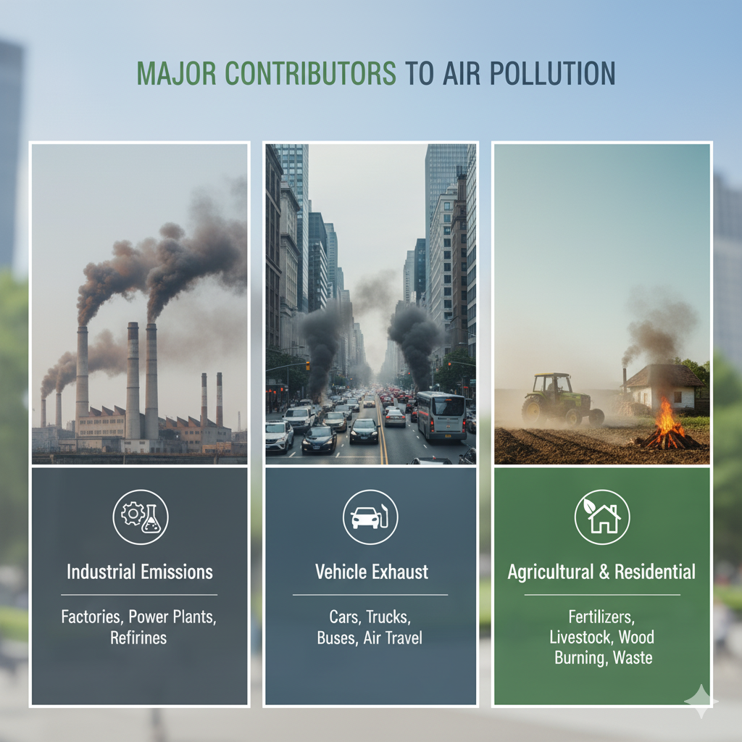
MAJOR CONTRIBUTORS TO AIR POLLUTION
Beyond the major headlines of stubble burning, many local sources are key contributors to poor air quality:
Solid Fuel Combustion (for cooking/heating)
Biomass & Wood Burning
Diesel Generators
Construction and Demolition Dust
Other Industrial Irritants and Processes

Slide 8
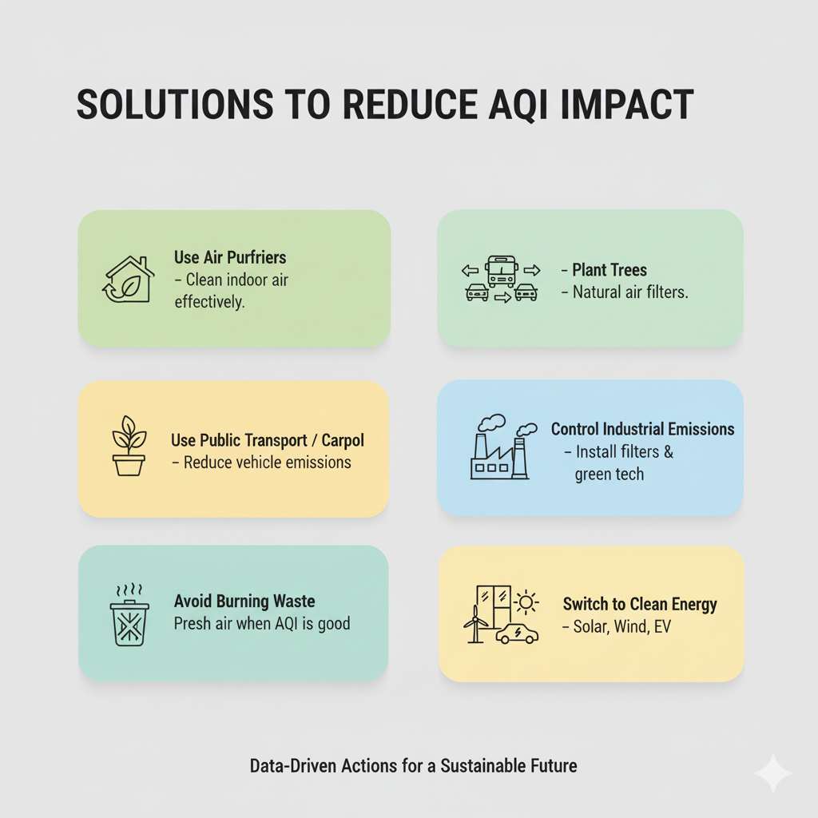
Harmful to Human Health and earth
For Humans:
High AQI indicates harmful pollutants like PM2.5, PM10, NO₂, SO₂, CO, and O₃ in the air.
Causes respiratory and cardiovascular diseases such as asthma, bronchitis, and heart issues.
Leads to eye irritation, headaches, fatigue, and worsens health for children and the elderly.
Long-term exposure can significantly reduce life expectancy.
For the Earth:
Ground-level ozone damages crops, forests, and reduces agricultural productivity.
Acid rain from SO₂ and NOx harms soil, water bodies, and infrastructure.
Particulate matter affects cloud formation, accelerates global warming, and disrupts ecosystems.
Smog and reduced visibility impact wildlife and natural habitats.

Slide 9
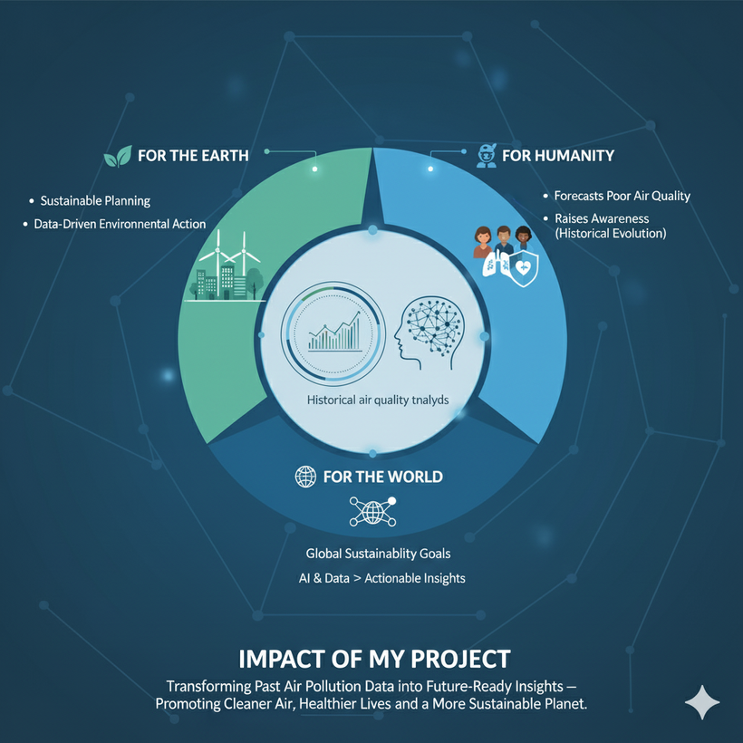
IMPACT OF MY PROJECT
For the Earth:
Analyzes historical trends to reveal long-term pollution patterns.
Enables sustainable and data-driven environmental action.
For Humanity:
Predicts poor air quality to protect public health.
Increases awareness of changing air conditions.
For the World:
Supports global sustainability goals for clean air and health.
Demonstrates the power of AI in turning data into impact.
In Short:
Transforms past air data into future-ready insights for a cleaner, healthier, and sustainable world.

Slide 10
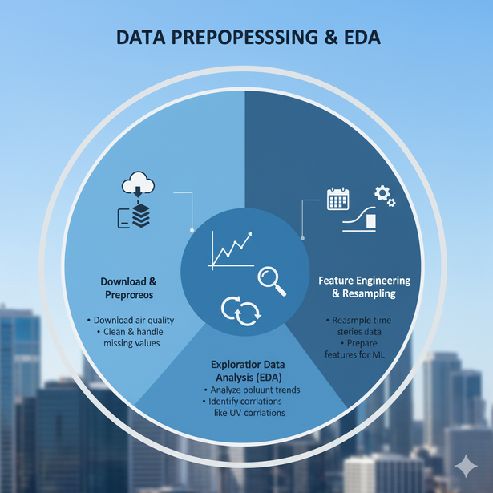
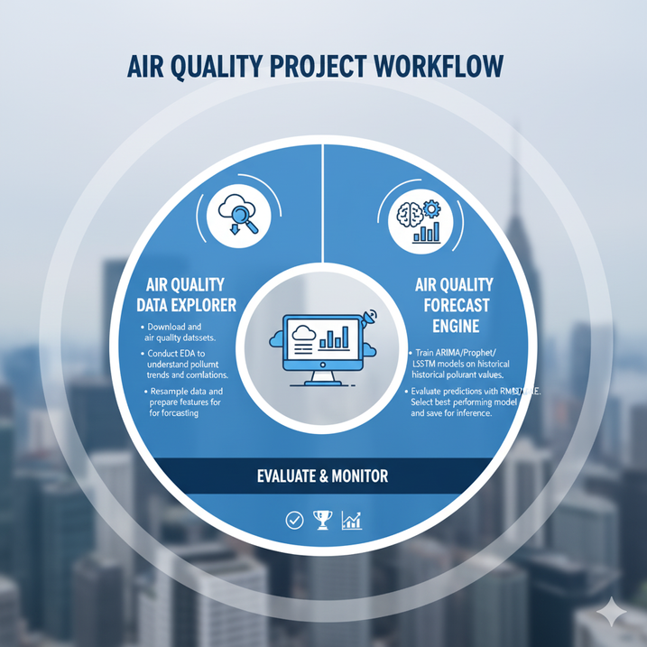
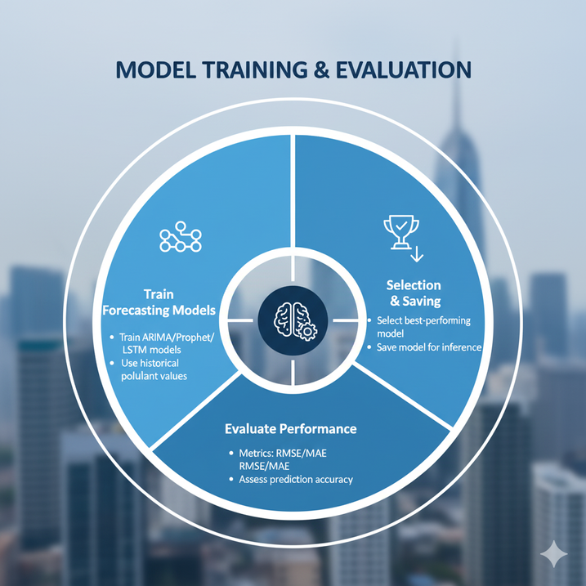
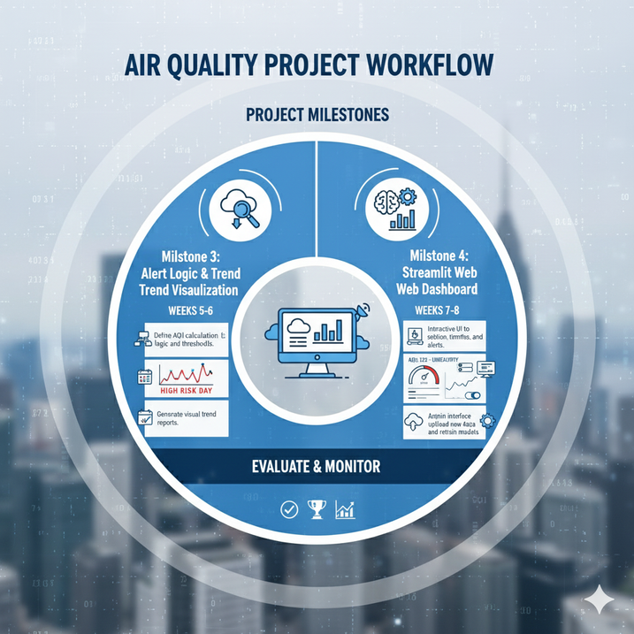
Milestone 1
MILESTONE 3
MILESTONE 2
MILESTONE 4
Data Preprocessing & EDA
Download and preprocess air quality datasets.
Conduct EDA to understand pollutant trends and correlations.
Resample data and prepare features for forecasting.
Dashboards
1. Air Quality Data Explorer
2. Air Quality Forecast Engine
Module: Model Training & Evaluation
Train ARIMA/Prophet/LSTM models on historical pollutant values.
Evaluate predictions with RMSE/MAE.
Select best-performing model and save for inference.
Dashboards
3. Air Quality Alert System
4. Streamlit Web Dashboard

Slide 11
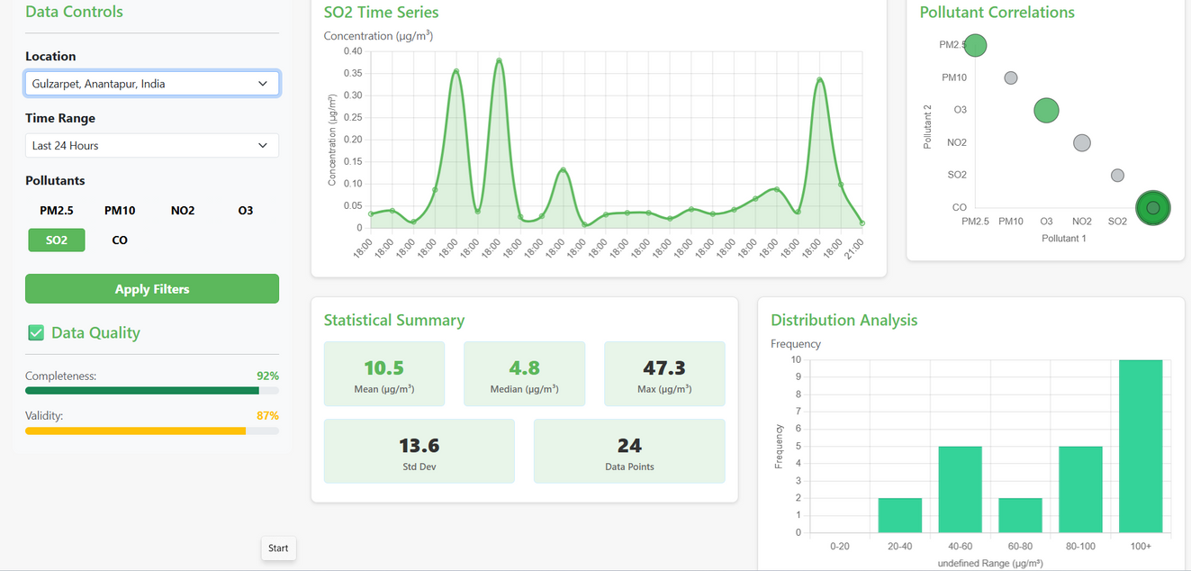
AIR QUALITY DATA EXPLORER
Frontend & Visualization (Web)
HTML: Structures the dashboard layout and allows for dynamic insertion of cities into the dropdown.
CSS/Bootstrap 5: Provides the clean, responsive design and styling.
JavaScript: Handles all client-side logic, user interaction, and data fetching.
Chart.js: A Powerful library used for all visualizations:
Line Chart (Time Series)
Bar Chart (PM2.5 Distribution)
Bubble Chart (Pollutant Correlations)
Backend & Data Processing (Python)
Flask: Lightweight web framework for building the API and serving the dashboard.
Pandas & NumPy: Core tools for data loading, cleaning, and preparation.
Scikit-learn (sklearn): Used specifically for Min-Max Scaling of the air quality data (0-1 range).
API Logic: Handles dynamic data retrieval based on City and Pollutant filters.
Steps to Run the Air Quality Dashboard (AirAware Dashboard 1)
File Setup: Ensure you have app.py, data_handler.py, the required templates/ and static/ folders, and the Dataset_AQI4-5 - Copy.csv file in your project root
Install: Open your terminal and run :
pip install Flask pandas numpy scikit-learn flask-cors
3. Run Server: Execute the main application file:
python app.py
4. Access: Open your web browser to: http://127.0.0.1:5000

Slide 12
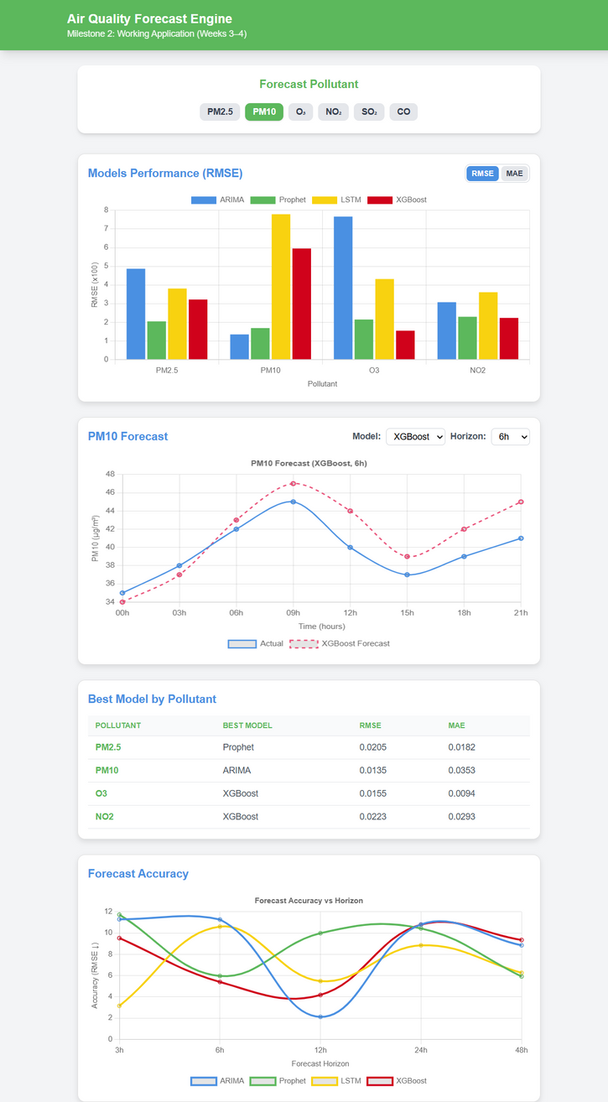
AIR QUALITY FORECAST ENGINE
Frontend & Visualization (Web)
UI/Style (index.html, Tailwind)
Structure: HTML defines the layout, including controls (buttons, selectors) and chart areas.
Styling: Tailwind CSS provides a fast, responsive, and utility-first design.
2. Logic (app.js)
Data Fetching: Initiates AJAX calls to the Flask API (/api/data) upon user input.
Interactivity: Handles clicks on Pollutant buttons and changes in Model/Horizon selectors to refresh data dynamically.
3. Charts (Chart.js)
Tool: Uses the Chart.js library for all graphics.
Visuals: Renders Grouped Bar Charts (Model Performance), Line Charts (Forecast), and updates them instantly with new JSON data.
Backend & Data Processing (Python)
1. Flask Backend (API)
Role: Web server; defines the API route /api/data to serve dashboard data.
Key Action: Safely defaults the city for data requests.
2. Data Pipeline (data_handler.py)
Load & Clean
Imputation: Fills missing values (NaN) using the median.
ML Prep (Scaling): Applies MinMaxScaler to normalize pollutant data to a 0-to-1 range.
Visualization
Steps to Run the Air Quality Forecast Engine(AirAware Dashboard 2)
Install Python: Ensure Python 3.8+ is ready.
Install Dependencies: Run pip install Flask pandas numpy scikit-learn flask-cors.
Place Data: Put Dataset_AQI4-5 - Copy.csv in the root folder.
Run Server: Execute python app.py.
Access: Open http://127.0.0.1:5001/ in your browser.

Slide 13
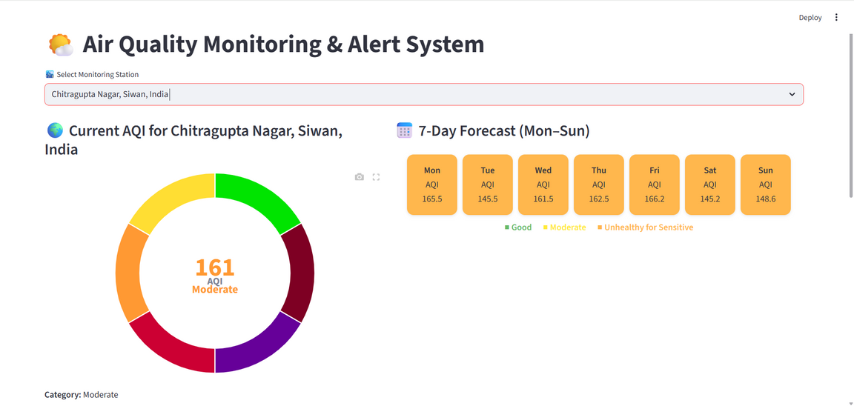
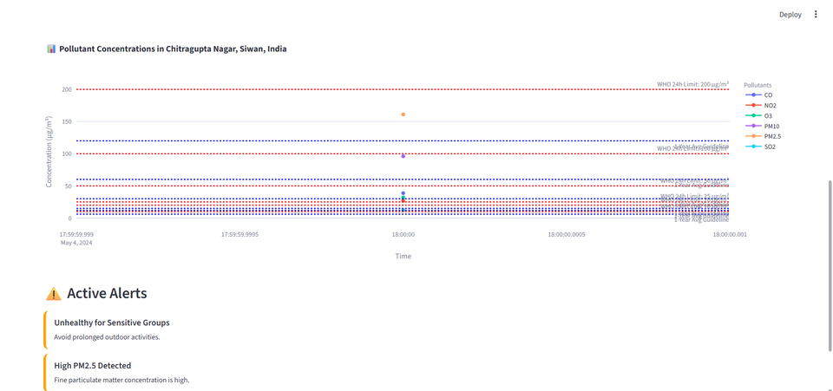
ALERT LOGIC & TREND VISUALIZATION
Flask (Backend API)
Role: Server-Side data engine.
Functions: Data Processing (Cleaning, Imputation, Scaling), Modeling Logic, and serving JSON data via API.
Streamlit (Frontend Dashboard)
Role: Client-Side interface.
Functions: Provides the Interactive UI, requests data from Flask, and renders dynamic charts (Chart.js/Plotly).
Steps to Run the Alert Logic & Trend Visualization(AirAware Dashboard 3)
1. Setup
Install Dependencies: Run pip install -r air_quality_api/requirements.txt and pip install -r air_quality_dashboard/requirements.txt.
2. Start the Flask Backend (API)
Navigate: cd air_quality_api
Execute: python api.py
Status: Must remain running (usually on port 5002).
3. Start the Streamlit Frontend (Dashboard)
Navigate (New Terminal): cd air_quality_dashboard
Execute: streamlit run dashboard_app.py
Access: Open the browser link provided by Streamlit (usually http://localhost:8501).

Slide 14
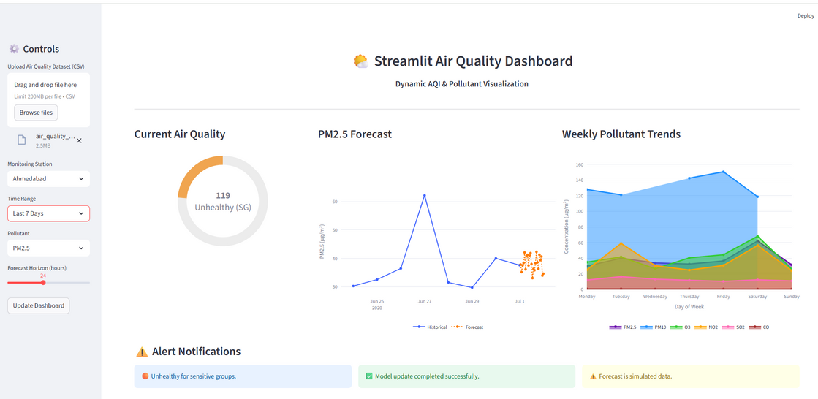
STREAMLIT WEB DASHBOARD
System Architecture
Controls (Sidebar): Users select Station, Time Range, Pollutant, and Forecast Horizon.
Processing: Upon button click, the app runs Python code (Pandas/Scikit-learn) internally to:
Load & Filter the dataset.
Calculate the Current AQI (e.g., Unhealthy).
Run the Forecast Model (e.g., 24 hours of PM2.5).
Visualization: Streamlit instantly renders the output:
AQI Gauge
Forecast Chart (Historical line + Prediction dots)
Trends Chart (Weekly pollutant levels)
Alerts: Displays Alert Notifications based on the calculated AQI status.
Steps to Run the Streamlit Web Dashboard(AirAware Dashboard 4)
Open your project folder in VS Code or any IDE.
Ensure you have Python 3.8 or higher installed.
Open the terminal inside the project directory.
Install required libraries: pip install streamlit pandas numpy plotly.
Run the dashboard using: streamlit run app.py.
Wait for the local URL to appear and click to open in your browser.
Explore interactive AQI trends, pollutant data, and model insights in real time.

Slide 15
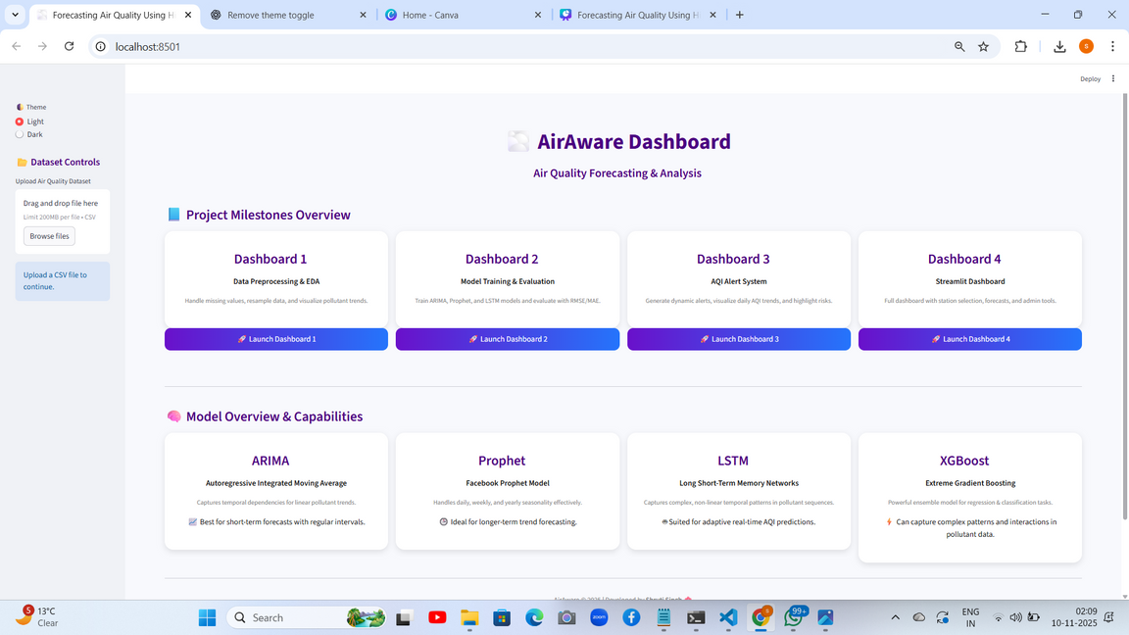
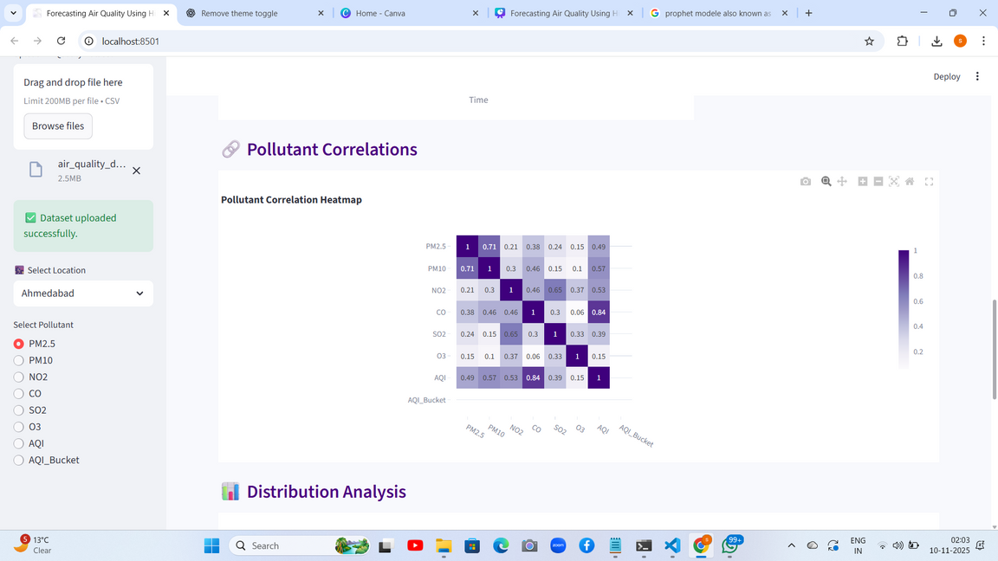
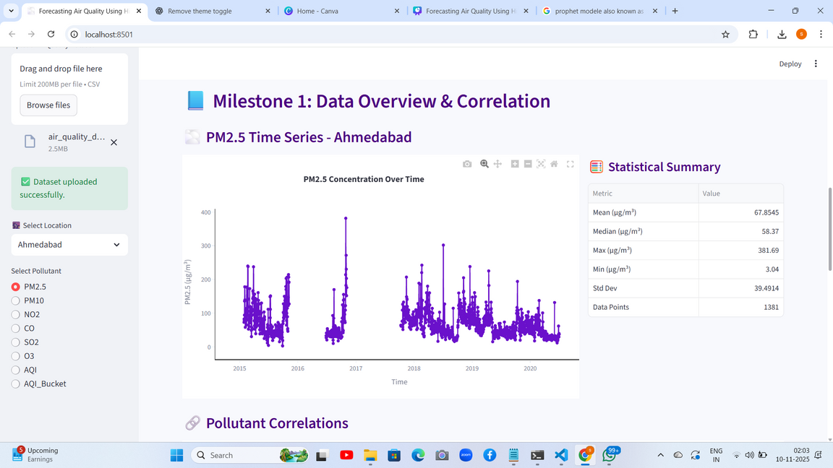
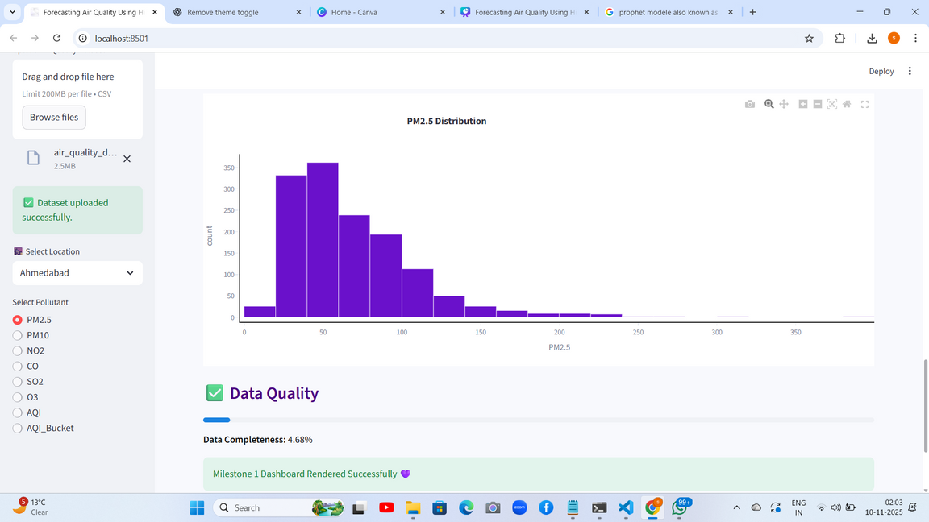
MAIN DASHBOARD

Slide 16
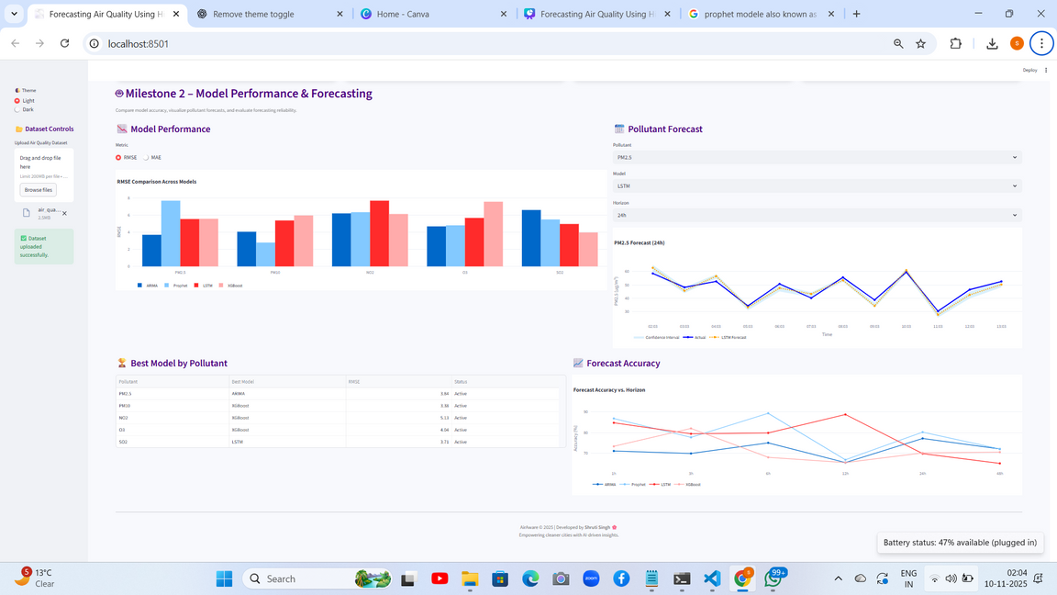
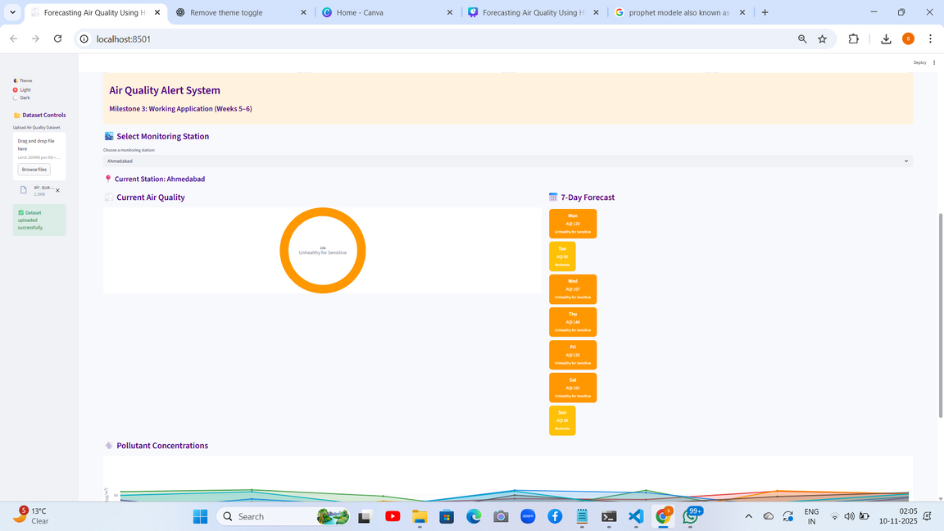
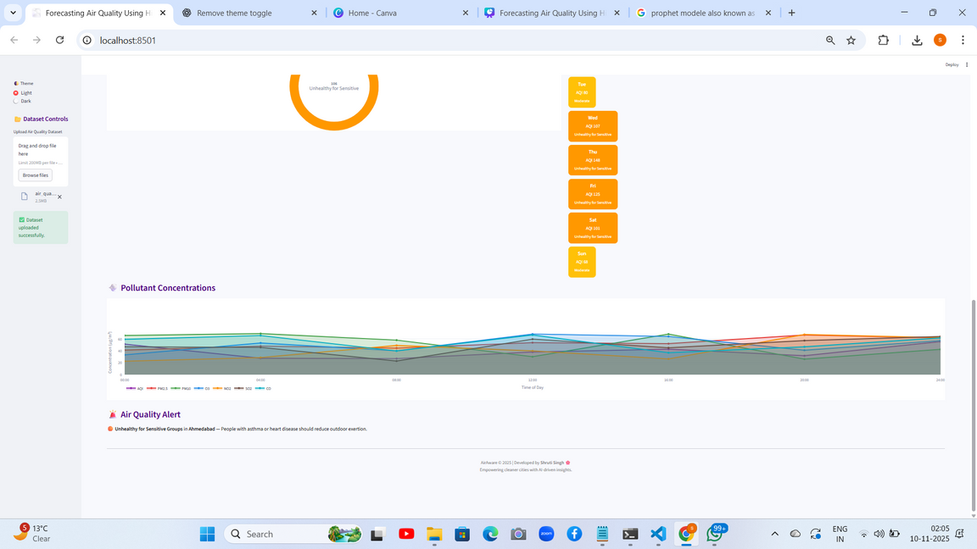
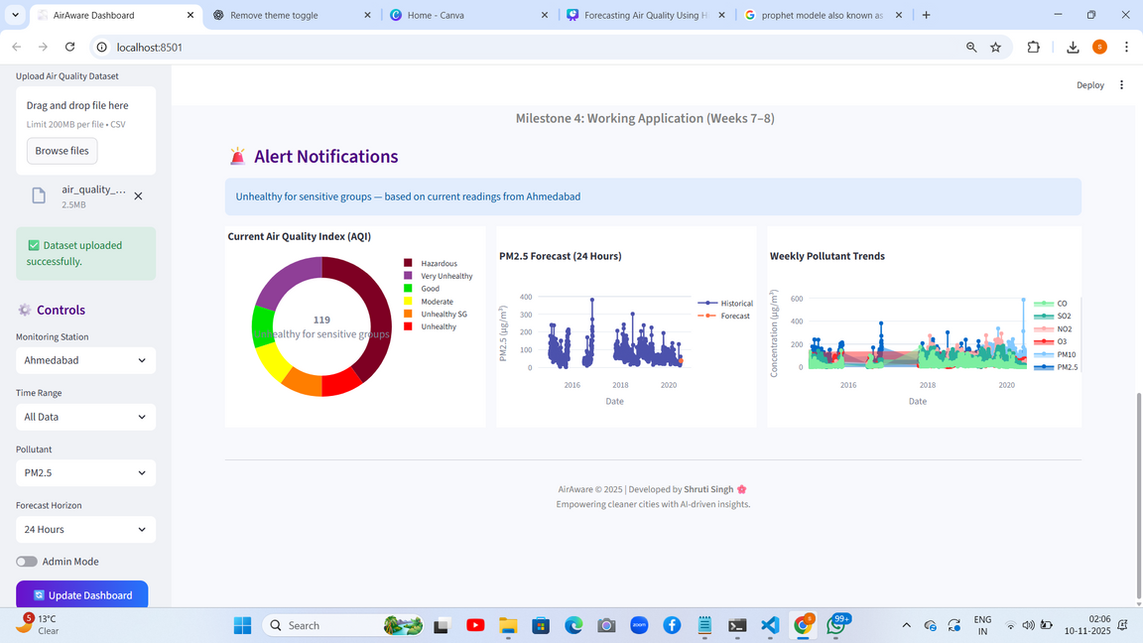
Steps to Run the Main Dahboard(air_quality_app)
.1.Setup & Install
Install Libraries: Install the core dependencies directly: pip install streamlit pandas numpy scikit-learn.
2. Execute the Application
Run Dashboard: Execute the app from your terminal: streamlit run app.py.
3. Load Data & Go!
Access: Open the browser link provided by Streamlit (usually http://localhost:8501/).
Upload: On the dashboard's sidebar, use the Upload Air Quality Dataset (.csv) function to load your file.

Slide 17
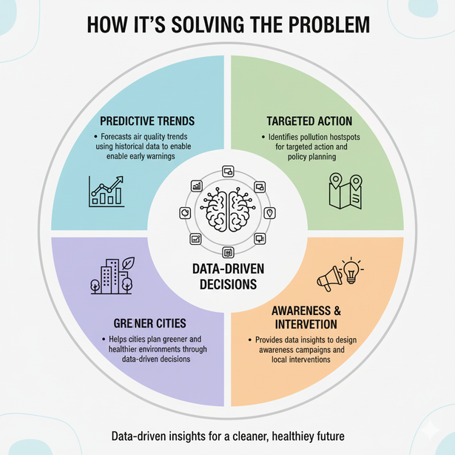
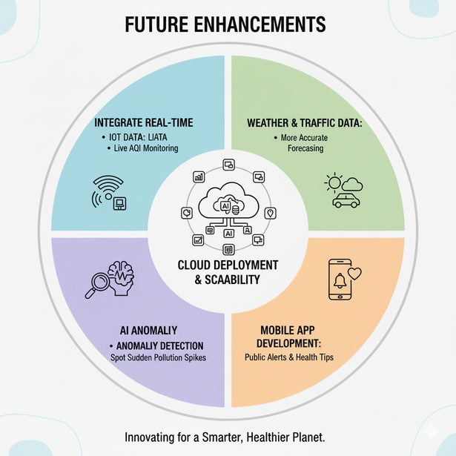
HOW IS IT SOLVING & WHAT DO YOU THINK CAN BE THE FUTURE ENHANCEMENTS
Future Enhancements:
Integrate real-time IoT sensor data for live AQI monitoring.
Include weather and traffic data for more accurate forecasting.
Develop a mobile app for public air quality alerts and health tips.
Deploy the system on cloud for scalability and multi-city comparison.
Add AI-based anomaly detection to spot sudden pollution spikes.
How It’s Solving the Problem:
Predicts air quality trends using historical data to enable early warnings.
Identifies pollution hotspots for targeted action and policy planning.
Provides data insights to design awareness campaigns and local interventions.
Helps cities plan greener and healthier environments through data-driven decisions.

Slide 18
Github repository

Slide 19
Thank you

